Slide 1
Mathematical Foundations for Data Science
MFDS Team

Slide 2
DSECL ZC416, MFDS
Lecture No.1

Slide 3

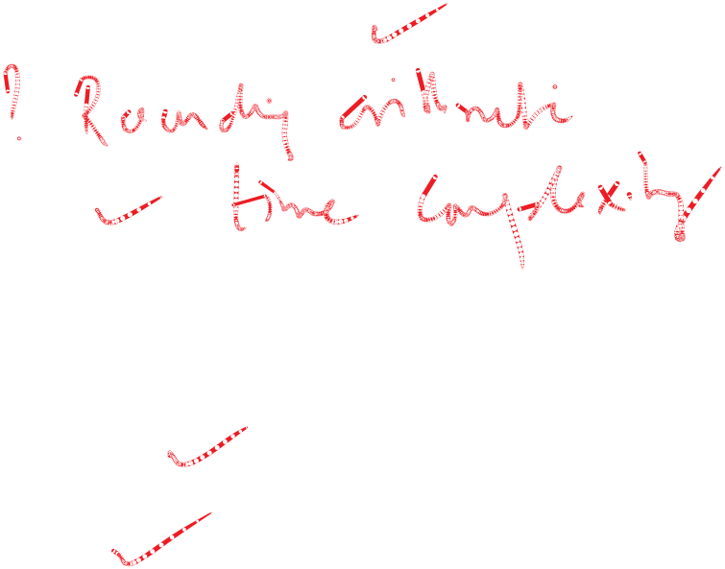


Agenda
Solution of linear systems – an overview
Gauss elimination methods
  sensitivity to changes in A
  pivoting and
  operations count
LU decomposition methods
  Doolittle’s method
  Crout’s method

Slide 4



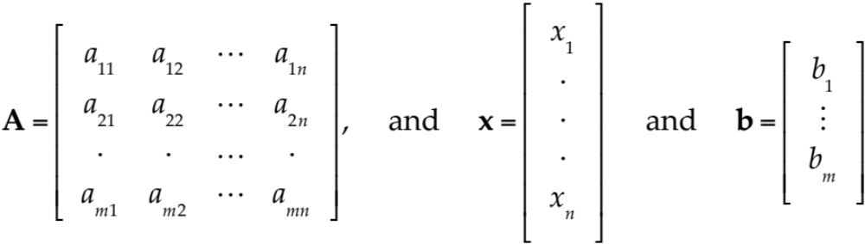


Linear System
Matrix Form of the Linear System (1).
From the definition of matrix multiplication we see that the m equations of (1) may be written as a single vector equation
(2) Ax = b
where the coefficient matrix A = [a_{jk}] is the m × n matrix
are column vectors.

Slide 5

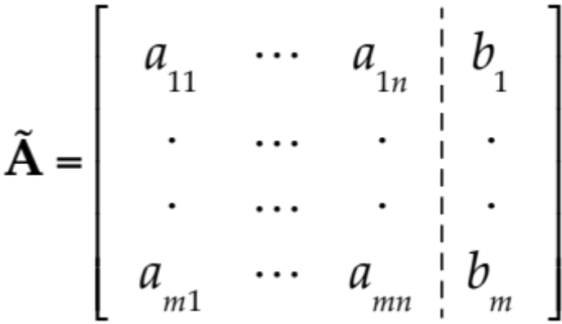













Matrix Form of Linear System
Matrix Form of the Linear System (1). (continued)
We assume that the coefficients a_{jk} are not all zero, so that A is not a zero matrix. Note that x has n components, whereas b has m components. The matrix
is called the augmented matrix of the system (1). The dashed vertical line could be omitted, as we shall do later. It is merely a reminder that the last column of Ã did not come from matrix A but came from vector b. Thus, we augmented the matrix A.

Slide 6
Gauss Elimination and Back Substitution
Triangular form:
Triangular means that all the nonzero entries of the corresponding coefficient matrix lie above the diagonal and form an upside-down 90° triangle. Then we can solve the system by back substitution.
Since a linear system is completely determined by its augmented matrix, Gauss elimination can be done by merely considering the matrices.
(We do this again in the next example, emphasizing the matrices by writing them first and the equations behind them, just as a help in order not to lose track.)

Slide 7
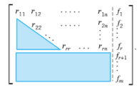
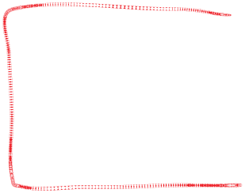




Gauss Elimination
At the end of the Gauss elimination (before the back substitution), the row echelon form of the augmented matrix will be
in upper triangular form
having the first r rows non-zero
Exactly (m – r) rows would be zero rows
the rhs would also have the last (m-r) rows zero
any one of the (m-r) last rows in non-zero would imply inconsistency
complexity is O(n³), where n is the number of rows
facilitates the back substitution

Slide 8
Solution
The number of nonzero rows, r, in the row-reduced coefficient matrix R is called the rank of R and also the
rank of A. Here is the method for determining whether
Ax = b has solutions and what they are:
(a) No solution. If r is less than m (meaning that R actually has at least one row of all 0s) and at least one of the numbers f_{r+1}, f_{r+2}, … , f_{m} is not zero, then the system Rx = f is inconsistent: No solution is possible. Therefore the system Ax = b is inconsistent as well.

Slide 9
Solution
If the system is consistent (either r = m, or r < m and all the numbers f_{r+1}, f_{r+2}, … , f_{m} are zero), then there are solutions.
(b) Unique solution. If the system is consistent and r = n, there is exactly one solution, which can be found by back substitution.
(c) Infinitely many solutions. To obtain any of these solutions, choose values of x_{r+1}, … , x_{n} arbitrarily. Then solve the rth equation for x_{r} (in terms of those arbitrary values), then the (r − 1)st equation for x_{r−1}, and so on up the line.

Slide 10
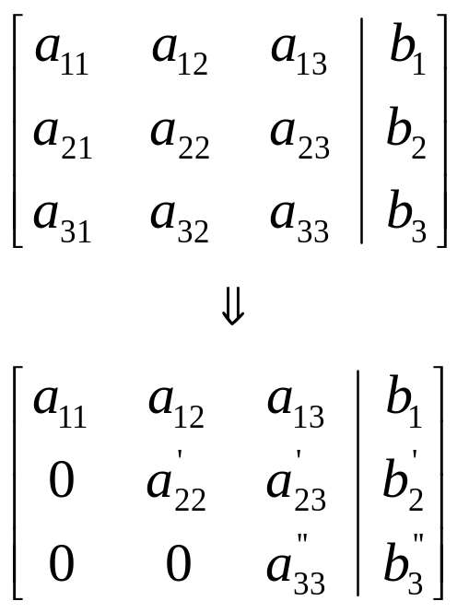



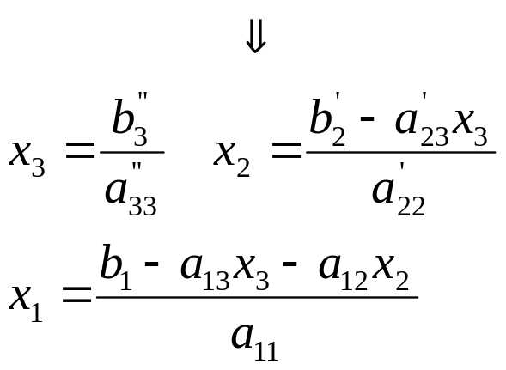

Gauss Elimination
Solve Ax = b
Consists of two phases:
  Forward elimination
  Back substitution
Forward Elimination
reduces Ax = b to an upper triangular system Tx = b’
Back substitution can then solve Tx = b’ for x
Forward
Elimination
Back
Substitution

Slide 11
Pitfalls of Gauss Elimination
Division by zero
It is possible that during both elimination and back-substitution phases a division by zero can occur.
For example:
2x₂ + 3x₃ = 8 0 2 3
4x₁ + 6x₂ + 7x₃ = -3 A = 4 6 7
2x₁ + x₂ + 6x₃ = 5 2 1 6
Solution: Pivoting
a₁₁ = 0
(the pivot element)
It is possible that during both elimination and back-substitution
phases, a division by zero can occur.

Slide 12
Pitfalls of Gauss Elimination
Round-off errors
Because computers carry only a limited number of significant figures,
round-off errors will occur and they will propagate from one iteration to
the next.
This problem is especially important when large numbers of equations
(100 or more) are to be solved.
Always use double-precision numbers/arithmetic. It is slow but
needed for correctness!
It is also a good idea to substitute your results back into the original
equations and check whether a substantial error has occurred.

Slide 13
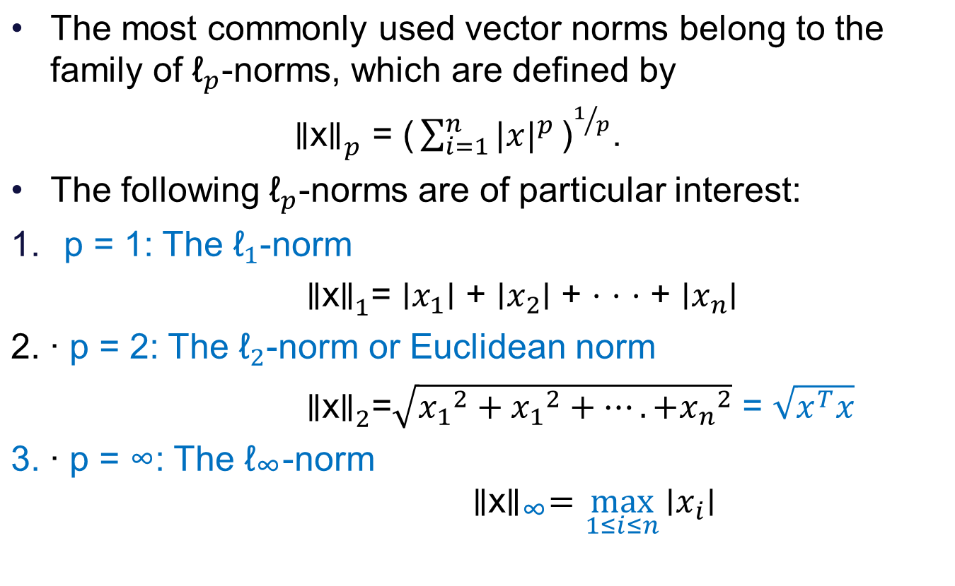



Common norms

Slide 14
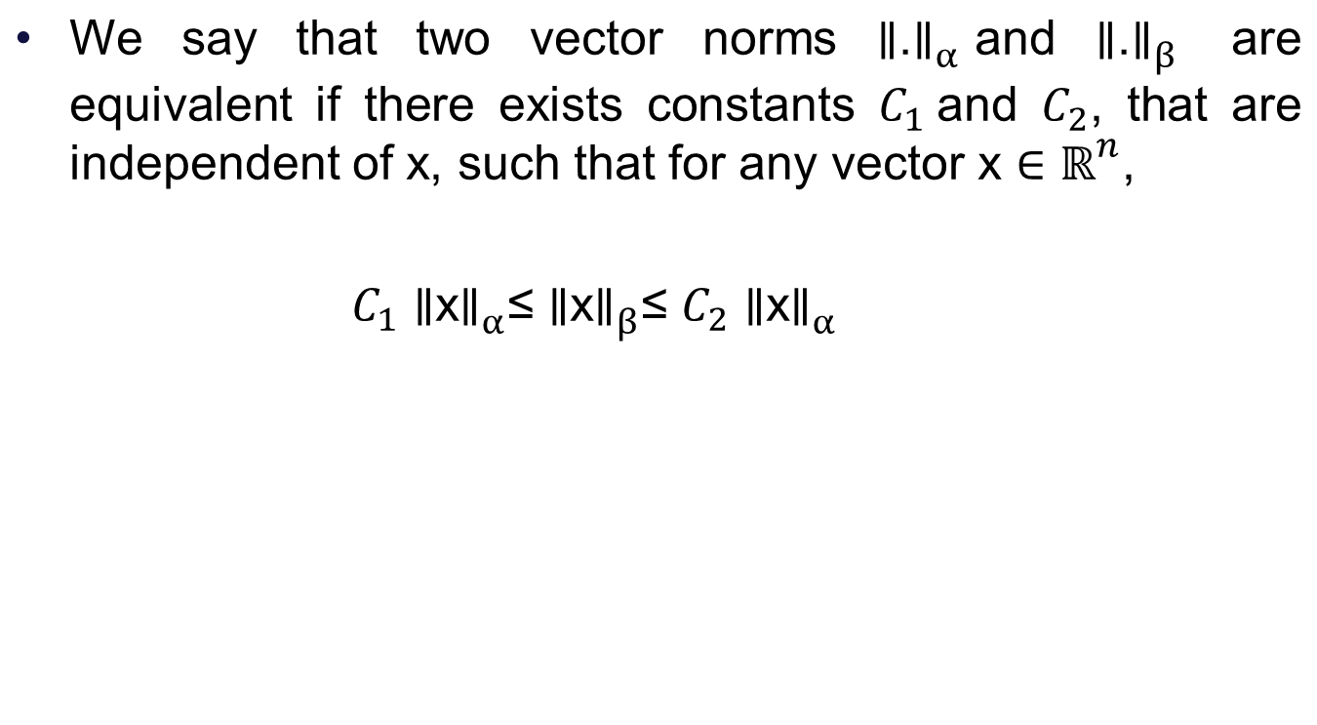
Equivalence of norms

Slide 15
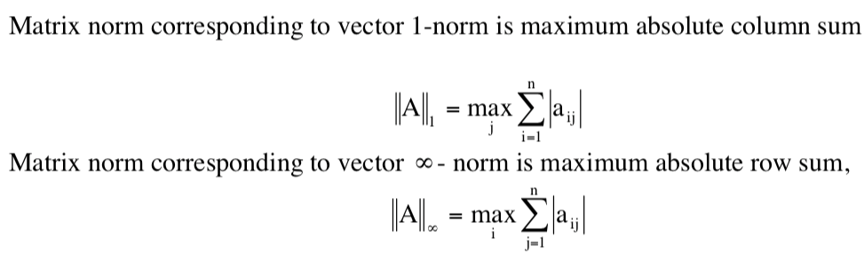



Matrix Norms
Some of the commonly used matrix norms are given below

Slide 16
Ill conditioned systems
  Systems where small changes in coefficients result in large change in solution
    x₁ + 2x₂ = 10
    1.1x₁ + 2x₂ = 10.4
  x₁ + 2x₂ = 10
    1.05x₁ + 2x₂ = 10.4
  → x₁ = 4.0 & x₂ = 3.0
  → x₁ = 8.0 & x₂ = 1.0

Slide 17

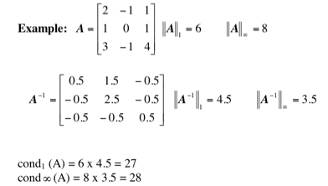
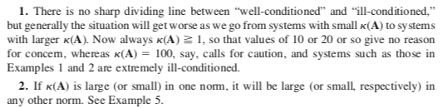
Condition Number
Condition number of a non singular matrix A is defined by
By convention, cond (A) = ∞ if A is singular

Slide 18
Techniques for Improving the solution
Use of more significant figures – double precision
arithmetic
Pivoting
If a pivot element is zero, normalization step leads to division by
zero. The same problem may arise, when the pivot element is close to
zero. Problem can be avoided:
  Partial pivoting
  Switching the rows below so that the largest element is the pivot element.
  Complete pivoting
  Searching for the largest element in all rows and columns then switching.
  This is rarely used because switching columns changes the order of x’s and adds significant complexity and overhead ➔ costly
Scaling - used to reduce the round-off errors and improve accuracy

Slide 19
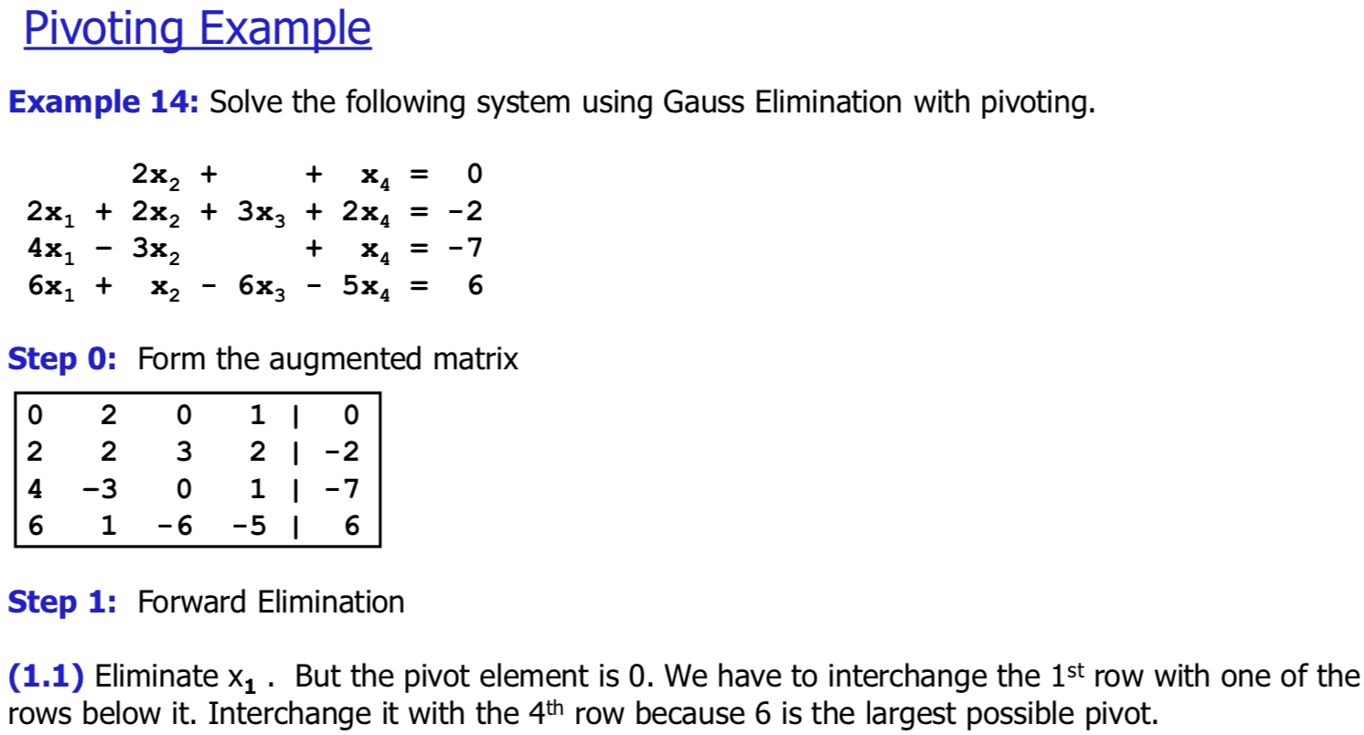
Partial Pivoting – Example

Slide 20
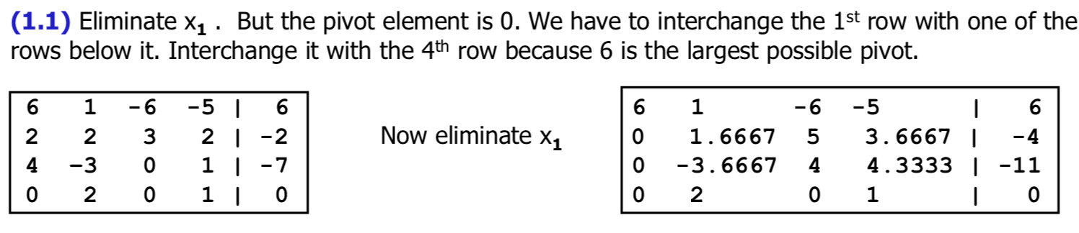
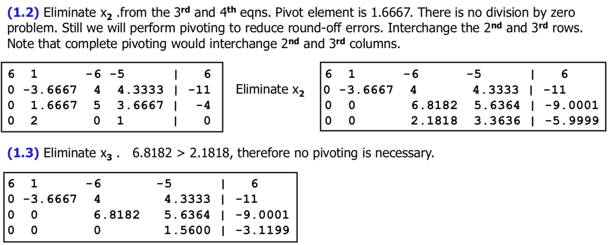
Partial Pivoting – Example

Slide 21
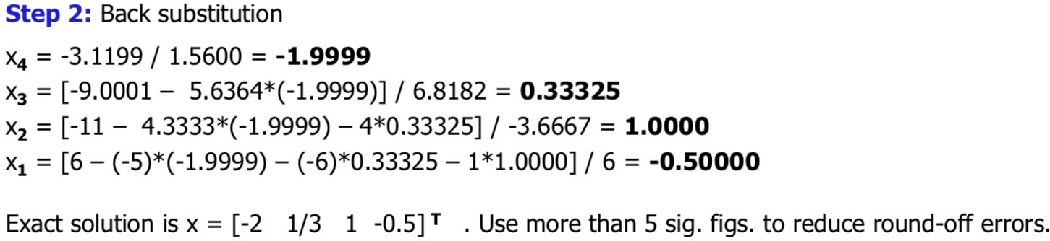
Partial Pivoting – Example

Slide 22
Gauss Elimination with Rounding
0.0004x₁ + 1.402x₂ = 1.406
0.4003x₁ – 1.502x₂ = 2.501
Original solution of the system is x₁ = 10, x₂ = 1
Picking the first of given equation as pivot equation , we
have to multiply this equation by m = 0.4003/0.0004 = 1001
and subtract result from the second equation , obtaining
-1405x₂ = -1404 ➔ x₂ = 0.9993
From first equation we get x₁ = 12.5
The failure occurs because |a₁₁| is small compared to |a₁₂|
so that a small round off error in x₂ led to a large error in x₁

Slide 23
Gauss Elimination with Rounding
0.0004x₁ + 1.402x₂ = 1.406
0.4003x₁ – 1.502x₂ = 2.501
Picking the second of the given equations as the pivot
equation, we have to multiply this equation by
0.0004/0.4003 = 0.0009993 and subtract the result from the
first equation obtaining
1.404x₂ = 1.404
x₂ = 1 and x₁ = 10
Note |a₂₁| is not very small compared to |a₂₂| so that a
small round off error in x₂ would not lead to a large error
in x₁

Slide 24
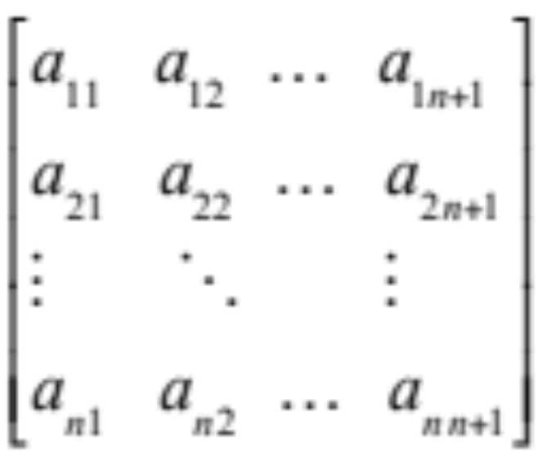
Operation Count – Gauss Elimination
Important factors in judging the quality of a numerical
method are
- Amount of storage
- Amount of time (= number of operations)
Consider Augmented Matrix of Ax = b, where a_{in+1}= b_{i}

Slide 25
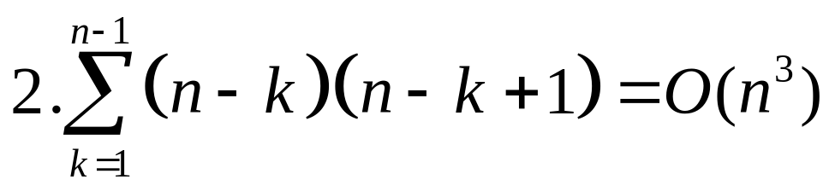

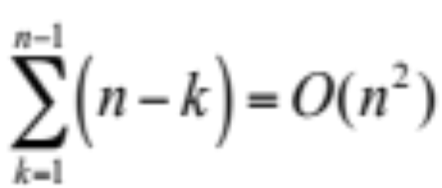
Operation Count – Gauss Elimination
In elimination procedure to get the rank we will make all elements below main diagonal zero.
Total number of multiplications and additions required to determine the rank by elimination procedure are
Total number of divisions is

Slide 26
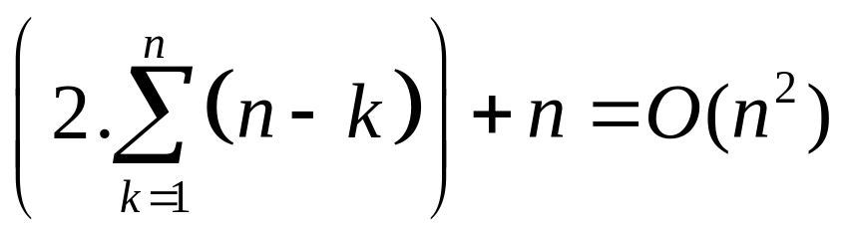
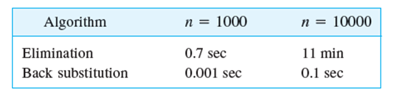


Operation Count – Gauss Elimination
In back substitution total number of additions, multiplications and divisions required are
If an operation takes 10⁻⁹ sec, then

Slide 27
LU Factorization
We write square matrix A as
A = LU
Doolittle’s Method : L is lower triangular matrix
diag(L) = 1, l_{ii} = 1 and U is
upper triangular matrix
Crout’s Method : U is upper triangular matrix with
diag(U) = 1, u_{ii} = 1 and L is lower
triangular matrix
Cholesky’s Method: U = L^{T}

Slide 28
Benefits of LU Decomposition
A = LU, Thus, the system Ax = b, is
LUx = b
Let Ux = y, then
Ly = b
Algorithm :-
Step-I Solve Ly = b, to find y.
Step-II Then solve Ux = y to find x

Slide 29
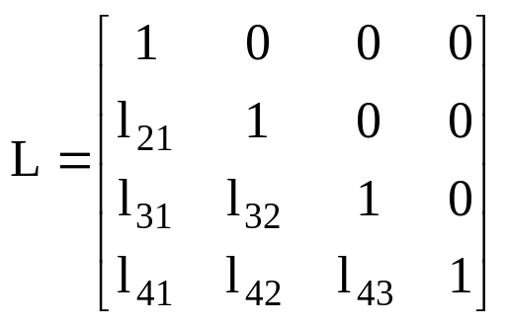
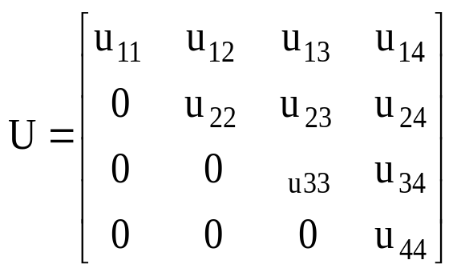
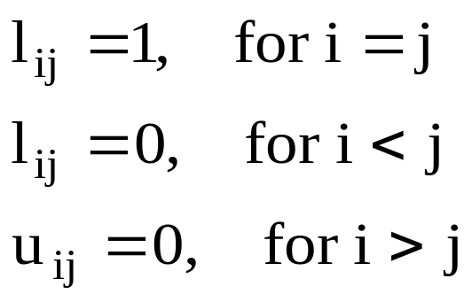
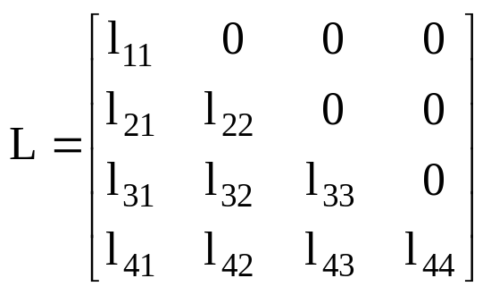
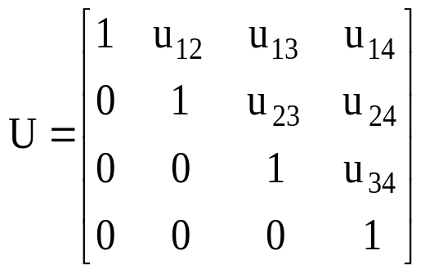
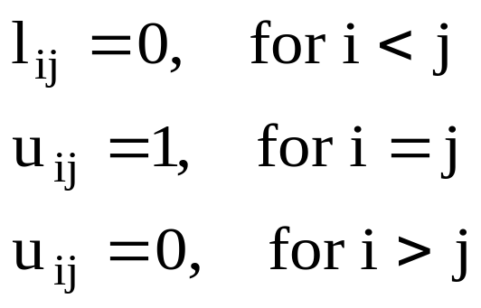
Methods of LU Factorization
Doolittle Method: The Factors L, U are defined as
Crout’s Method: The Factors L, U are defined as

